Slide 1
宏观经济学
Macroeconomics
杨芷晴
yangzhiqing@hust.edu.cn
2025Feb
I (Zhiqing Yang yangzhiqing@hust.edu.cn)

Slide 2
课堂纪律与考核标准
平时成绩20%+期末考试80%
平时考核：考勤、上课互动、章节作业
期末考试
I (Zhiqing Yang yangzhiqing@hust.edu.cn)
2023Feb

Slide 3
教材与学习资料
1. 教材
《西方经济学》编写组：《西方经济学（下册）》，高等教育出版社（马克思主义理论研究和建设工程重点教材）
2. 推荐学习资料
书籍：《贫穷的本质》，《我们的孩子/OUR KIDS: The American Dream in Crisis》，《枪炮、病菌与钢铁》( Jared Diamond), 《为什么有的国家富裕、有的国家贫穷/Comparing Human Societies》(Jared Diamond)
期刊：经济研究、管理世界、经济学季刊、Journal of Development Economics, China Economic Review
I (Zhiqing Yang yangzhiqing@hust.edu.cn)
2023-Feb

Slide 4
课程基本结构
第1章 宏观经济学的基本指标及其衡量
  第1节 国内生产总值
  第2节 价格水平及其衡量
  第3节 失业及其衡量
第2章 短期经济波动模型：产品市场的均衡
  第1节 均衡国民收入的决定 第4节 政府需求
  第2节 消费需求与储蓄 第5节 国外需求
  第3节 投资需求 第6节 乘数
第3章 短期经济波动模型：产品市场和货币市场的共同均衡
  第1节 产品市场的均衡：IS模型
  第2节 货币市场的均衡：LM模型
  第3节 产品市场和货币市场的共同均衡：IS-LM模型
第4章 短期经济波动模型：总需求-总供给分析
  第1节 总需求曲线及其变动
  第2节 总供给曲线及其变动
  第3节 总需求-总供给模型
第5章 开放经济的宏观经济学
第6章 宏观经济政策
第7章 通货膨胀与失业理论
I (Zhiqing Yang yangzhiqing@hust.edu.cn)
2023-Feb

Slide 5
产品市场
国民收入决定的收入—支出模型
国民收入决定的IS-LM模型
货币市场
总需求-总供给模型
AD-AS模型
劳动市场
开放经济下的IS-LM-BP模型
国际市场
宏观经济学的基本理论框架
I (Zhiqing Yang yangzhiqing@hust.edu.cn)
Macroeconomics
2023-Feb

Slide 6
宏观经济学
Macroeconomics
第一章 宏观经济学的基本指标及其衡量
第1节 国内生产总值
I (Zhiqing Yang yangzhiqing@hust.edu.cn)
2023-Feb

Slide 7
本节要解决以下问题
宏观经济学研究什么？
什么是国内生产总值（GDP）？
GDP与一国的总收入与总支出有什么联系？
GDP由哪几部分组成？
GDP怎么进行通货膨胀的校正？
GDP是衡量经济福利的好指标吗？

Slide 8
Open discuss：你想生活在什么样的国家？

Slide 9
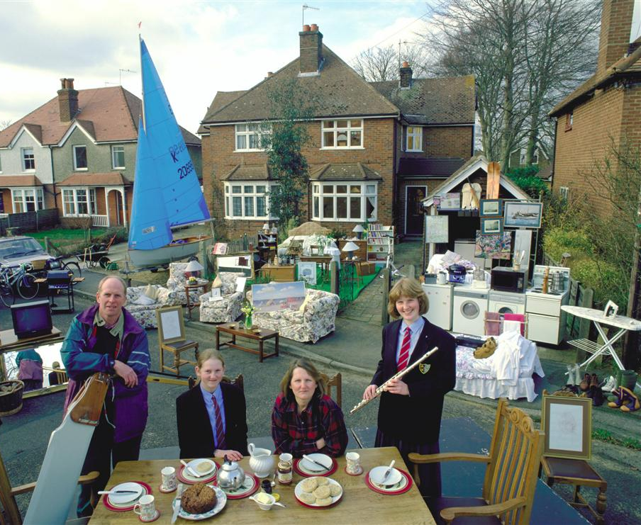
Notes:
9
This and the next two slides are from the FYI box entitled “A Picture is Worth A Thousand Statistics.” These photos put a human face on the statistics and theories. Many students connect to these pictures more than to the data in Table 1.
For each picture, the family was paid to drag all of its stuff outside for the photo.
Before revealing the statistics in the lower left-hand corner, let your students soak in the picture for a moment. Point out some of the lovely things the family owns – the sailboat, the house with two chimneys and two bay windows in front, the state-of-the-art washer/dryer, and so forth.
Data sources:
GDP per capita, 2006: Same as textbook.
Life expectancy at birth, 2008 estimate. Source: U.S. Census Bureau, International Database.
http://www.census.gov/ipc/www/idb/idbprint.html
Adult literacy, 2003 estimate. Source: CIA World Factbook.
https://www.cia.gov/library/publications/the-world-factbook/

Slide 10

Notes:
10
Again, let your students have a good look at the photo before revealing the statistics in the lower left corner.
This family seems comfortable, but they don’t have quite as much stuff as the British family. No sailboat. No house with bay windows.
But they’re not doing so bad. To many students (especially in America), an income of $11,000 seems incredibly poor. But relative to the rest of the world, it’s not so bad.
Data sources:
GDP per capita, 2006: Same as textbook.
Life expectancy at birth, 2008 estimate. Source: U.S. Census Bureau, International Database.
http://www.census.gov/ipc/www/idb/idbprint.html
Adult literacy, 2004 estimate. Source: CIA World Factbook.
https://www.cia.gov/library/publications/the-world-factbook/

Slide 11
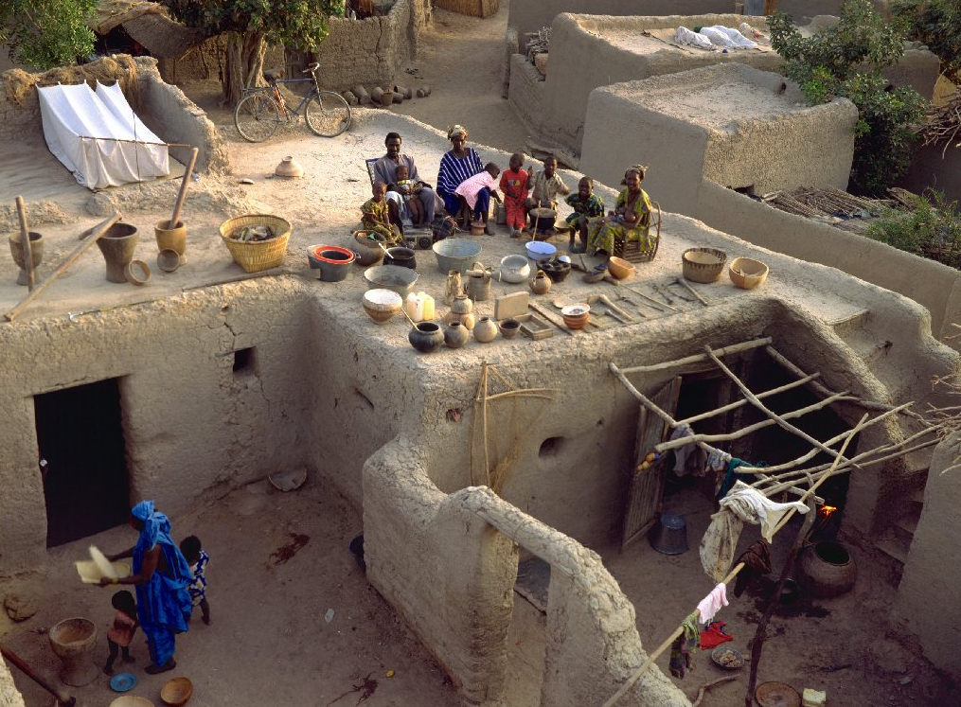
Notes:
11
Here, the photo really is worth a thousand words. Look at the family’s possessions. Pottery, a few sticks, some clothing, and a dwelling that does not appear to have running water or climate control. That’s it. No sailboat, no upholstered furniture, no bicycles. This family is very poor.
Now look at the statistics - $1130 income per capita? Heck, I spend that much on Starbucks drinks each year. Life expectancy is frighteningly low. And less than half the population can read or write their own language – most students can readily grasp that it’s hard to grow out of poverty if over half of the population is illiterate.
Data sources:
GDP per capita, 2006: Same as textbook.
Life expectancy at birth, 2008 estimate. Source: U.S. Census Bureau, International Database.
http://www.census.gov/ipc/www/idb/idbprint.html
Adult literacy, 2003 estimate. Source: CIA World Factbook.
https://www.cia.gov/library/publications/the-world-factbook/

Slide 12
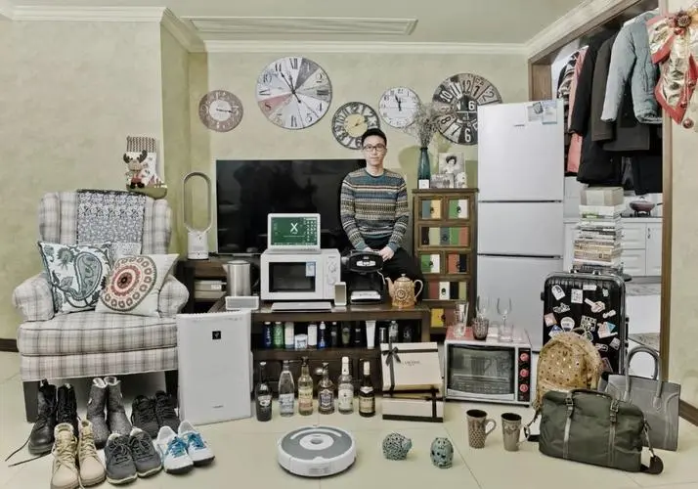

Slide 13
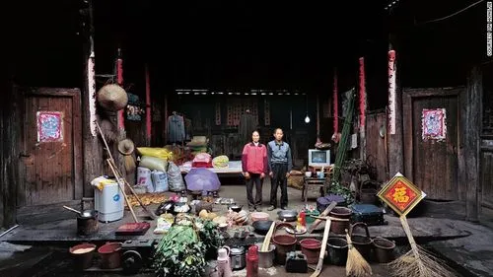
一个中国普通家庭及其所有财产
人均GDP ： $12,700
预期寿命： 75.4岁
成人识字率： 96.4%

Slide 14
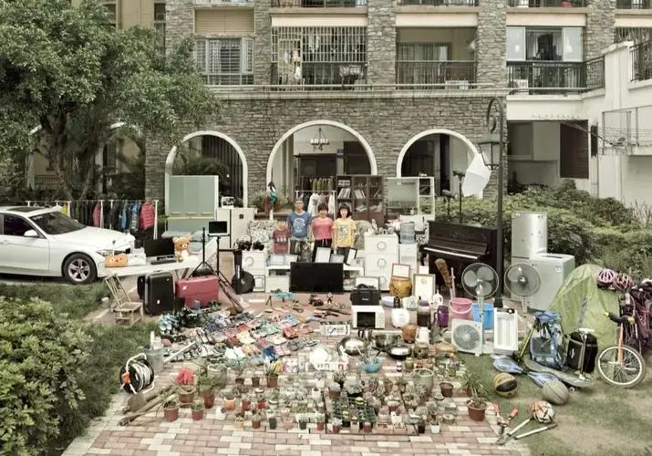

Slide 16
一个英国普通家庭及其所有财产，发达国家
人均GDP ： $35,580
预期寿命： 79 岁
成人识字率： 99%
Notes:
16
This and the next two slides are from the FYI box entitled “A Picture is Worth A Thousand Statistics.” These photos put a human face on the statistics and theories. Many students connect to these pictures more than to the data in Table 1.
For each picture, the family was paid to drag all of its stuff outside for the photo.
Before revealing the statistics in the lower left-hand corner, let your students soak in the picture for a moment. Point out some of the lovely things the family owns – the sailboat, the house with two chimneys and two bay windows in front, the state-of-the-art washer/dryer, and so forth.
Data sources:
GDP per capita, 2006: Same as textbook.
Life expectancy at birth, 2008 estimate. Source: U.S. Census Bureau, International Database.
http://www.census.gov/ipc/www/idb/idbprint.html
Adult literacy, 2003 estimate. Source: CIA World Factbook.
https://www.cia.gov/library/publications/the-world-factbook/

Slide 17
一个墨西哥普通家庭及其所有财产，中等收入国家
人均GDP：$11,410
预期寿命：76 岁
成人识字率：92%
Notes:
17
Again, let your students have a good look at the photo before revealing the statistics in the lower left corner.
This family seems comfortable, but they don’t have quite as much stuff as the British family. No sailboat. No house with bay windows.
But they’re not doing so bad. To many students (especially in America), an income of $11,000 seems incredibly poor. But relative to the rest of the world, it’s not so bad.
Data sources:
GDP per capita, 2006: Same as textbook.
Life expectancy at birth, 2008 estimate. Source: U.S. Census Bureau, International Database.
http://www.census.gov/ipc/www/idb/idbprint.html
Adult literacy, 2004 estimate. Source: CIA World Factbook.
https://www.cia.gov/library/publications/the-world-factbook/

Slide 18
一个马里普通家庭及其所有财产，发展中国家
人均GDP ： $1,130
预期寿命： 50 岁
成人识字率： 46%
Notes:
18
Here, the photo really is worth a thousand words. Look at the family’s possessions. Pottery, a few sticks, some clothing, and a dwelling that does not appear to have running water or climate control. That’s it. No sailboat, no upholstered furniture, no bicycles. This family is very poor.
Now look at the statistics - $1130 income per capita? Heck, I spend that much on Starbucks drinks each year. Life expectancy is frighteningly low. And less than half the population can read or write their own language – most students can readily grasp that it’s hard to grow out of poverty if over half of the population is illiterate.
Data sources:
GDP per capita, 2006: Same as textbook.
Life expectancy at birth, 2008 estimate. Source: U.S. Census Bureau, International Database.
http://www.census.gov/ipc/www/idb/idbprint.html
Adult literacy, 2003 estimate. Source: CIA World Factbook.
https://www.cia.gov/library/publications/the-world-factbook/

Slide 19
微观经济学与宏观经济学
微观经济学:
研究家庭和企业如何做出决策，以及它们如何在市场上相互交易
宏观经济学：
研究整体经济现象
我们从国家的总收入和总支出开始学习宏观经济学
Notes:
19
This is the first strictly macro chapter of the textbook, so it’s worth spending a moment emphasizing the difference between microeconomics and macroeconomics.
Examples of questions that microeconomics seeks to answer:
How do consumers decide how much of each good to buy?
How do firms decide how much output to produce and what price to charge?
What determines the price and quantity of individual goods and services?
How do taxes on specific goods and services affect the allocation of resources?
Examples of questions that macroeconomics seeks to answer:
How do consumers decide how to divide their income between spending and saving?
What determines the total amount of employment and unemployment?
What determines the overall level of prices and the rate of inflation?
Why does the economy go through cycles, where things are great for a few years (like the late ’90s) and then lousy for a year or two (like 2001-2002)?
When unemployment is high, what can the government do to help?

Slide 20
微观经济学与宏观经济学
微观经济学:
研究家庭和企业如何做出决策，以及它们如何在市场上相互交易
宏观经济学：
研究整体经济现象
我们从国家的总收入和总支出开始学习宏观经济学
Notes:
20
This is the first strictly macro chapter of the textbook, so it’s worth spending a moment emphasizing the difference between microeconomics and macroeconomics.
Examples of questions that microeconomics seeks to answer:
How do consumers decide how much of each good to buy?
How do firms decide how much output to produce and what price to charge?
What determines the price and quantity of individual goods and services?
How do taxes on specific goods and services affect the allocation of resources?
Examples of questions that macroeconomics seeks to answer:
How do consumers decide how to divide their income between spending and saving?
What determines the total amount of employment and unemployment?
What determines the overall level of prices and the rate of inflation?
Why does the economy go through cycles, where things are great for a few years (like the late ’90s) and then lousy for a year or two (like 2001-2002)?
When unemployment is high, what can the government do to help?

Slide 21
宏观经济学研究什么
经济增长
通货膨胀
失业
国际经济
……
Notes:
21
If your students already know the terms “factors of production” and “factor payments,” you may wish to delete the “preliminaries” from this slide.

Slide 22
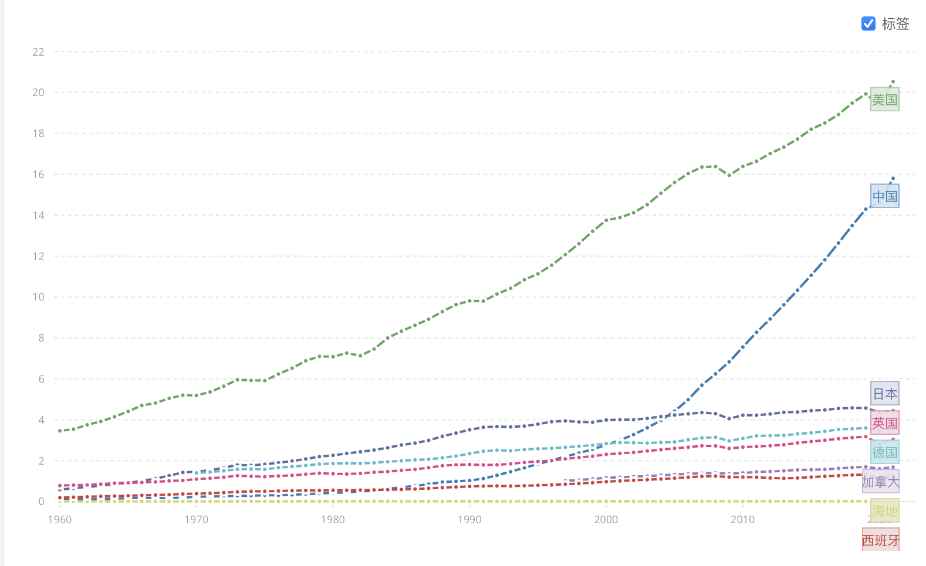
1. 经济增长
事实1: 世界各国的经济增长有很大差别
1960-2021年全球各主要经济体GDP（2015年不变价美元）
Source：世界银行数据库
Notes:
22
Source: World Development Indicators, World Bank, and my calculations.
GDP per capita is in PPP$. “Growth rate” is the average annual growth rate of real GDP per capita (local currency), computed as
{ln(2005 value)-ln(1960 value)}/45
Exceptions:
The growth rates shown for Canada and Saudi Arabia were computed over 1965-2005 and 1968-2005, respectively, due to missing early years of real GDP data in the World Development Indicators.
This table is similar to Table 1 in the textbook. There are two differences.
First, the set of countries is slightly different. I have excluded Mexico and the U.K. because they (and data on their GDP per capita) were featured in the photos. I have excluded Germany because unification there makes earlier data not comparable with recent data, and thus complicates the calculation of the growth rate. Other countries from Table 1 excluded here are Brazil, Indonesia, Pakistan, and Bangladesh. The table on this slide includes the following countries, which do not appear in Table 1: Singapore, Spain (I wanted at least one country from Europe), Israel (it’s in the news often), Saudi Arabia (I wanted at least one OPEC country), Colombia (they make good coffee there, plus I wanted a couple countries from S. America), New Zealand (Oceania’s representative here), the Philippines, Rwanda and Haiti (representative poor countries, different from Table 1 just for variety).
Second, growth rates here are computed over 1960-2005 (except Canada and S. Arabia, as noted above).
The purpose of this table (and of Table 1 in the text) is to convey the following two facts:
1) There are great differences in the standard of living across countries.
2) There are great differences in the growth rates across countries.
A corollary is that the rankings of countries can change over time: Countries at the bottom need not remain there – witness Japan and China, both of whom were far poorer in 1960.

Slide 23
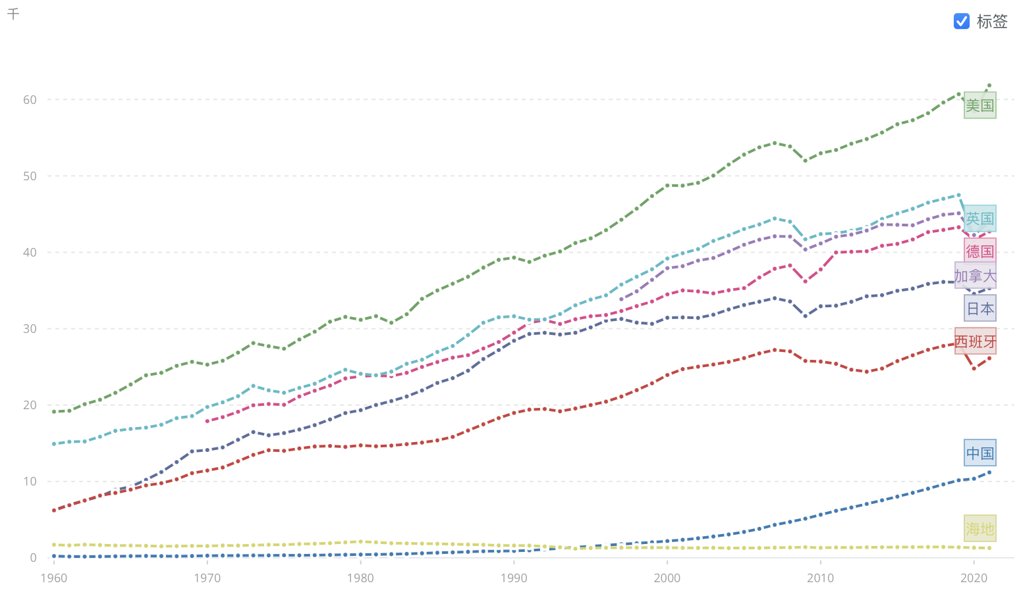
1. 经济增长
1960-2021年全球各主要经济体人均GDP（2015年不变价美元）
Source：世界银行数据库

Slide 24
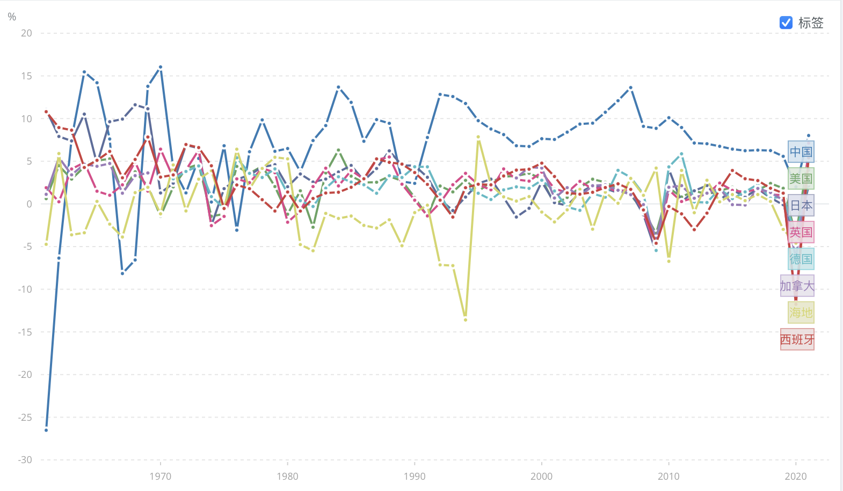
事实 2: 世界各国的经济增长率有很大差别
1960-2021年全球各主要经济体人均GDP增长率
Source：世界银行数据库

Slide 25
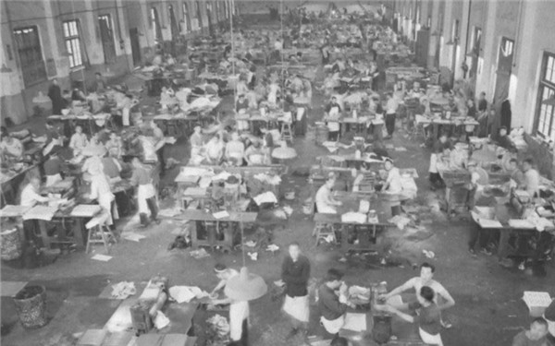
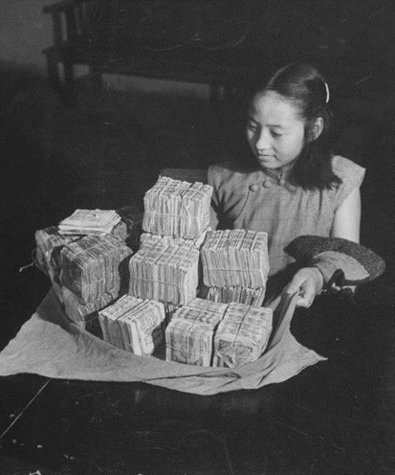
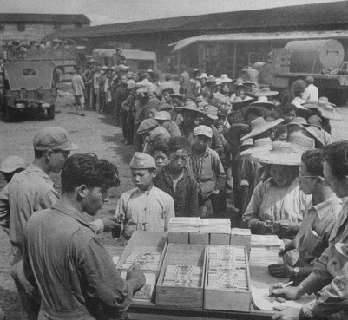
2. 通货膨胀
左上图：印钞厂的一幕
左下图：民众用一麻袋装的钱放到黄包车上
右 图：买东西的妇女所带的钱

Slide 26


电影：《当幸福来敲门》
3. 失业
失业的基本问题：
劳动市场是否总是均衡的，哪些因素影响了劳动市场的均衡？
市场经济能否自发地保持充分就业？
失业率是否越低越好？
The Pursuit of Happyness

Slide 27
收入与支出
国内生产总值 (GDP) 衡量经济中所有人的总收入
GDP也衡量用于经济中物品与劳务生产的总支出
对一个整体经济而言，
收入等于支出
因为某个买者的1美元支出正是某个卖者的1美元收入
Notes:
27
Notes:
1. The text in the first bullet point is NOT the formal textbook definition of GDP. The formal definition is given and discussed in detail immediately after the Circular-Flow Diagram.
2. “g&s” = goods and services
A good way to judge how well someone is doing economically is to look at his or her income. We can judge how well a country is doing economically by looking at the total income that everyone in the economy is earning. GDP is our measure of the economy’s total income, often called “national income.”
GDP also measures total expenditure on the goods and services produced in the economy, and the value of the economy’s output (production) of goods and services. Thus, GDP is also referred to as “output.”
The equality of income and expenditure is an accounting identity (not, for example, an equilibrium condition): it must be true that income equals expenditure.

Slide 28
GDP的循环
一千零一夜 第10集《小镇传奇》
【【720P】一千零一夜 01—50【国语】-哔哩哔哩】 https://b23.tv/qQ4EvcK
钱为什么要散出去才能造福社会？

Slide 29



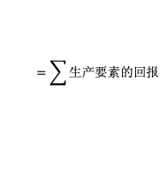
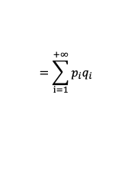
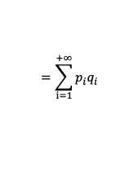
收入与支出的循环
家庭
总支出
家庭支出
$$=\sum_{i=1}^{+∞}{p_{i}q_{i}}$$
产品和服务
家庭
企业
家庭总收入
企业
总收入
$$=\sum_{i=1}^{+∞}{p_{i}q_{i}}$$
$$=\sum{生产要素的回报}$$
租金、利息、
工资、利润
土地、资本
劳动力、企业家精神
如何衡量一个国家的生产总值？

Slide 30
宏观经济学的第一个模型：循环流量图
宏观经济的一个简单描述
用支出，收益，要素支付和收入来说明GDP
预备知识：
  生产要素：诸如劳动，土地，资本，自然资源等投入
  要素支付：支付给生产要素的报酬（例如，工资，租金）
Notes:
30
If your students already know the terms “factors of production” and “factor payments,” you may wish to delete the “preliminaries” from this slide.

Slide 31
循环流量图
家庭:
拥有生产要素，出售或出租它们给企业以换取收入
购买并消费物品与劳务
企业
家庭
企业:
购买或租赁生产要素，用它们来生产物品与劳务
出售物品与劳务
Notes:
31
This and the following slide build the Circular-Flow Diagram piece by piece.

Slide 32
循环流量图
收入 (=GDP)
支出(=GDP)
物品与劳务市场
物品和劳务的销售
物品和劳务的购买
企业
家庭
生产投入
劳动、土地和资本
生产要素
市场
工资、租金和利润 (=GDP)
收入 (=GDP)
Notes:
32
In this diagram, the green arrows represent flows of income/payments. The red arrows represent flows of goods & services (including services of the factors of production in the lower half of the diagram).
To keep the graph simple, we have omitted the government, financial system, and foreign sector, as discussed on the next slide.
Changing the animation on this slide:
If you wish, you can easily change the order in which the markets and arrows appear. From the “Slide Show” drop-down menu, choose “Custom Animation…” Then, a box will appear (maybe along the right-hand-side of your PowerPoint window) that allows you to modify the order in which things appear (as well as other aspects of the animation). For further information, open PowerPoint help and search on “change the sequence of animations.”

Slide 33
这张图省略了什么
政府
  征税，购买物品与劳务
金融体系
  在储蓄者资金的供给和借款者贷款的需求之间达成均衡
外国部门
  物品与劳务贸易，金融资产，外国居民的货币
Notes:
33
In future chapters, we will study the role of each of these in greater detail.
We could draw a more complicated circular flow diagram that includes the government, financial system, and foreign sector. Including them, however, would not change the basic conclusion that GDP simultaneously measures the country’s total income, expenditure, revenue, and factor payments.

Slide 34
国内生产总值（GDP）：
在某一既定时期一个国家（或地区）内生产的所有最终物品与劳务的市场价值的总和
物品用它们的市场价值来评价，那:
所有物品都用相同的单位来衡量 (比如，在中国用人民币，在美国用美元……)
那些没有市场价值的物品被排除在外，比如你为自己而做的家务
Notes:
34
This slide and the five that follow focus on the meaning of each part of this critically important definition.
Note that transactions occurring in the so-called “underground economy” are also omitted from the official measure of GDP. In the textbook, near the end of this chapter, an “In the News” box contains an excellent article on the underground economy.

Slide 35
国内生产总值 (GDP) ：
在某一既定时期一个国家内生产的所有最终物品和劳务的市场价值
最终物品：为终端使用者所准备
中间物品：生产其他物品的一种组成成份或要素
GDP只包括最终产品—生产过程中使用的中间物品的价值已经包含在最终物品的价值中

Slide 36
国内生产总值 (GDP)：
在某一既定时期一个国家内生产的所有最终物品和劳务的市场价值
GDP包括有形的物品
(比如DVD, 山地自行车, 啤酒)
也包括无形的劳务
(比如干洗, 音乐会, 移动电话服务)

Slide 37
国内生产总值 (GDP)：
在某一既定时期一个国家内生产的所有最终物品和劳务的市场价值
GDP 只包括现期生产的物品，不包括过去生产的物品

Slide 38
国内生产总值 (GDP)：
在某一既定时期一个国家内生产的所有最终物品和劳务的市场价值
GDP 衡量的生产价值局限于一个国家的地理范围之内，不管是由本国的国民还是住在本国的外国人生产

Slide 39
国内生产总值 (GDP)：
在某一既定时期一个国家内生产的所有最终物品和劳务的市场价值
通常是一年或一个季度（3个月）

Slide 40
GDP的组成部分
GDP 是总支出
四个组成部分：
  消费 （C）
  投资 （I）
  政府购买 （G）
  净出口（NX）
这四个组成部分的总和等于GDP（用Y表示）：
Y = C + I + G + NX
Notes:
40
Each of the four components is defined and discussed in detail on the following slides.

Slide 41
消费 (C)
消费是指家庭除购买新住房之外用于物品和劳务的总支出
关于居住成本的注释：
  对租房者而言，消费包括租金
  对房主而言，消费包括住房的隐含租金价值，但不包括住房的购买价格或按揭贷款
Notes:
41
Mostly, the term “consumption” refers to what students probably already think of as total consumer spending. The note about the treatment of owner-occupied housing is an exception, and some of the test bank questions are designed to see if students remember this exception.
(For more on this issue, see the notes accompanying the following slide.)

Slide 42
投资 （I）
投资是对用于未来生产更多物品和劳务的物品的购买
包括下列支出：
  资本设备 (比如机器, 工具)
  建筑物(工厂，办公楼，住房)
  存货 (已经生产出来但尚未售出的物品)
注意: “投资 ”并不是指购买股票或债券这类金融资产
Notes:
42
More on the treatment of owner-occupied housing:
In the national income and product accounts, a house is considered a piece of capital that is used to produce a flow of services – housing services.
When a consumer (as a tenant) rents a house or apartment, the consumer is buying housing services. These services are considered consumption, so the price paid for these services – rent – is counted in the “consumption” component of GDP .
When someone buys a new house to live in, she is both a producer and a consumer. As a producer, she has made an investment (the purchase of the house) that will produce a service. She is also the consumer of this service, which is valued at the market rental rate for that type of house. So, the accounting conventions treat this situation as if the person is her own landlord and rents the house to/from herself.
When students begin to understand this, they may wonder why certain other goods (like cars) that produce a flow of consumer services are not also treated this way. There really is no good answer. It’s just a convention of the national income and product accounts.

Slide 43
政府购买 （G）
是地方、州、和联邦政府用于物品与劳务的支出。
政府购买不包括转移支付，比如社会保障补助或失业保险补助
因为它们不是物品与劳务的购买
Notes:
43
You might tell your students that transfer payments, like Social Security checks, are excluded from G to avoid double-counting: retired persons spend part or all of their Social Security benefits on food, rent, prescriptions, and so forth, all of which count in consumption. If we also counted the Social Security check as part of G, then the same money would be counted twice, which would make GDP look bigger than it really is.

Slide 44
净出口 （NX）
NX = 出口 – 进口
出口代表外国对国内生产物品与劳务的支出
进口是消费，投资和政府购买中对外国生产的物品和劳务的支出
把所有组成部分加总起来得到：
Y = C + I + G + NX
Notes:
44
The “net” in “net exports” refers to the fact that we are subtracting imports from exports. This subtraction is important, because imports are also counted in the other components of GDP; failing to subtract them would cause GDP to measure not just the value of goods produced domestically, but also goods produced abroad and imported.
For example, if a consumer spends $100 on a DVD player imported from Japan, that $100 counts in “consumption,” even though the player was not produced domestically. We subtract off that $100 import so that GDP ends up including the value of only domestically-produced goods and services.

Slide 45
主动学习 1
GDP及其组成部分
在下面的各种情形下，计算GDP及它受影响的组成部分的变化量
  A. 你在上海最好的饭店花了¥2000请你同学吃晚饭
  B. 你为了出版业务的需要，花¥5000买了一台新笔记本。这台笔记本是在美国制造的
  C. 你为了编辑业务的需要花了¥5000购买一台新电脑，这台电脑是由本地的制造商在去年生产的
  D. 通用汽车公司在中国生产了价值5亿美元的汽车，但消费者只购买了价值4.7亿美元的汽车
Notes:
Suggestion: Show these questions, and give your students 1-3 minutes to formulate their answers. When you are ready to discuss the answers, go to the next slide….

Slide 46
主动学习 1
参考答案
A. 你在上海最好的饭店花了¥2000请你同学吃晚饭
消费和 GDP都增加了2000元
B. 你为了出版业务的需要，花¥5000买了一台新笔记本。这台笔记本是在美国制造的
投资增加5000元，净出口减少5000元, GDP 不变
46
Notes:
Suggestion (continued from previous slide): Show part A (but not the answer) and ask for someone to volunteer his or her response. Then show the answer to part A. Repeat for parts B, C, and D. (The answers to parts C and D appear on the following slide.)
After showing the answer to part A, ask your students whether the answer would be different if Debbie were a government employee. The correct answer is NO. Government employees engage in consumption, just like everyone else.

Slide 47
主动学习 1
参考答案
C. 你为了编辑业务的需要花了¥5000购买一台新电脑，这台电脑是由本地的制造商在去年生产的
当前的GDP与投资都不变，因为电脑是在去年生产出来的
D. 通用汽车公司在中国生产了价值5亿美元的汽车，但消费者只购买了价值4.7亿美元的汽车
消费增加4.7亿美元，存货投资增加0.3亿，GDP 增加5亿美元
47
Notes:
Regarding part C:
Jane’s purchase causes investment (for her own business) to increase by $1200. However, the computer is sold out of inventory, so inventory investment falls by $1200. The two transactions cancel each other, leaving aggregate investment and GDP unchanged.
Regarding part D:
This problem illustrates why expenditure always equals output, even when firms don’t sell everything they produce due to lackluster demand. The point here is that unsold output is counted in inventory investment, even when that “investment” was unintentional.

Slide 48
真实GDP与名义GDP
通货膨胀会扭曲像GDP这样的经济变量，因此我们有两种类型的GDP：
一种是经过通货膨胀校正，另一种则没有
名义GDP 按现期价格评价的物品与劳务的生产，它没有经过通货膨胀校正
真实 GDP 按基年价格评价的物品与劳务的生产，它经过通货膨胀校正

Slide 49
例：
 | 皮萨 |  | 拿铁咖啡
年份 | P | Q | P | Q
2005 | $10 | 400 | $2.00 | 1000
2006 | $11 | 500 | $2.50 | 1100
2007 | $12 | 600 | $3.00 | 1200
计算每年的名义GDP：
2005: $10 x 400 + $2 x 1000 = $6,000
2006: $11 x 500 + $2.50 x 1100 = $8,250
2007: $12 x 600 + $3 x 1200 = $10,800
增加：
37.5%
30.9%
Notes:
49
This example is similar to that in the text, but using different goods and different numerical values.
Suggestion: Ask your students to compute nominal GDP in each year before revealing the answers. Ask them to compute the rate of increase before revealing the answers.
In this example, nominal GDP grows for two reasons: prices are rising, and the economy is producing a larger quantity of goods.
Thinking of nominal GDP as total income, the increases in income will overstate the increases in society’s well-being because part of these increases are due to inflation.
We need a way to take out the effects of inflation, to see how much people’s incomes are growing in purchasing power terms. That is the job of real GDP.

Slide 50
例：
 | 皮萨 |  | 拿铁咖啡
年份 | P | Q | P | Q
2005 | $10 | 400 | $2.00 | 1000
2006 | $11 | 500 | $2.50 | 1100
2007 | $12 | 600 | $3.00 | 1200
$10
$2.00
计算每年的真实GDP,
以2005 年作为基年:
增加：
2005: $10 x 400 + $2 x 1000 = $6,000
2006: $10 x 500 + $2 x 1100 = $7,200
2007: $10 x 600 + $2 x 1200 = $8,400
20.0%
16.7%
Notes:
50
This example shows that real GDP in every year is constructed using the prices of the base year and that the base year doesn’t change.
The growth rate of real GDP from one year to the next is the answer to this question:
“How much would GDP (and hence everyone’s income) have grown if there had been zero inflation?”
Thus, real GDP is corrected for inflation.

Slide 51
例:
年份 | 名义 GDP |  | 真实 GDP
2005 | $6000 |  | $6000
2006 | $8250 |  | $7200
2007 | $10,800 |  | $8400
每年,
名义GDP是用当期价格来衡量
真实GDP是用不变的基年价格来衡量（本例中以2005年作为基年）
Notes:
51
The table in the top half of this slide merely summarizes the answers from the previous two slides. This table will be used shortly to compute the growth rates in nominal and real GDP and to compute the GDP deflator and inflation rates.

Slide 52
例：
年份 | 名义 GDP |  | 真实 GDP
2005 | $6000 |  | $6000
2006 | $8250 |  | $7200
2007 | $10,800 |  | $8400
37.5%
20.0%
30.9%
16.7%
名义GDP的变化反映了价格与产量的变化
真实GDP的变化是价格不变时（就是零通货膨胀条件），GDP数量的变化
因此，真实 GDP经过通货膨胀校正
Notes:
52
Again, the growth rate of real GDP from one year to the next is the answer to this question:
“How much would GDP (and hence everyone’s income) have grown if there had been zero inflation?”
This is why real GDP is corrected for inflation.

Slide 53
美国的名义GDP与真实GDP：
1965-2007
真实GDP(基年是2000年)
名义GDP
53
Notes:
53
The source I used: http://research.stlouisfed.org/fred2/
The original source: U.S. Department of Commerce: Bureau of Economic Analysis
Note: This graph is different than the one in this chapter of the textbook. The one in the textbook excludes nominal GDP, but includes shaded vertical bars over the dates of each recession.
Since you have just finished covering real vs. nominal GDP, it might be worthwhile pointing out the following to your students:
The graph shows that nominal GDP rises faster than real GDP. This should make sense, because growth in nominal GDP is driven by growth in output AND by inflation. Growth in real GDP is driven only by growth in output.
The two lines cross in the year 2000 (the base year for the real GDP data in this graph). This should make sense because real GDP equals nominal GDP in the base year. (Better yet, ask your students whether there’s anything significant about the point where the two lines cross.)
Before the base year, real GDP > nominal GDP. For example, in 1970, nominal GDP is about $1 trillion, while real GDP is about $3.8 trillion (in 2000 dollars). This should make sense because prices were so much higher in 2000 than in 1970, so using those high 2000 prices to value 1970 output would lead to a bigger result than valuing 1970 output using 1970 prices.
Similarly, after 2000, nominal GDP is higher than real GDP because prices are higher in later years than they were in 2000.

Slide 54
GDP平减指数
GDP平减指数是对总体价格水平的衡量
定义:
GDP平减指数= 100 x
名义 GDP
真实 GDP
衡量经济通货膨胀率的一种方法是计算从一年到下一年GDP平减指数增加的百分比
Notes:
54
The GDP Deflator gets its name because it is used to “deflate” (i.e., take the inflation out of) nominal GDP to get real GDP.

Slide 55
例：
年份 | 名义 GDP | 真实 GDP | GDP 平减指数
2005 | $6000 | $6000
2006 | $8250 | $7200
2007 | $10,800 | $8400
100.0
14.6%
114.6
12.2%
128.6
计算每年的GDP 平减指数：
2005: 100 x (6000/6000) = 100.0
2006: 100 x (8250/7200) = 114.6
2007: 100 x (10,800/8400) = 128.6

Slide 56
主动学习 2
GDP的计算
 | 2007 (基年) |  | 2008 |  | 2009
 | P | Q | P | Q | P | Q
物品 A | $30 | 900 | $31 | 1,000 | $36 | 1050
物品 B | $100 | 192 | $102 | 200 | $100 | 205
使用上述数据解决以下问题：
  A. 计算 2007年的名义GDP
  B. 计算2008年真实GDP
  C. 计算2009年的GDP平减指数
56
Notes:
The data in the table are for a hypothetical economy that produces two final goods, A and B. For all parts of this problem, use 2007 as the base year.
If you’re running short on time, you can skip part A – it’s the least challenging. If you only have time for one of the three, you might skip A and B, as C by itself covers all of the material: it requires students to compute nominal and real GDP before they can compute the GDP deflator.

Slide 57
主动学习 2
参考答案
 | 2007 (基年) |  | 2008 |  | 2009
 | P | Q | P | Q | P | Q
物品 A | $30 | 900 | $31 | 1,000 | $36 | 1050
物品 B | $100 | 192 | $102 | 200 | $100 | 205
A. 计算2007年的名义GDP
$30 x 900 + $100 x 192 = $46,200
B. 计算2008年的真实GDP
$30 x 1000 + $100 x 200 = $50,000
57

Slide 58
主动学习 2
参考答案
 | 2007 (基年) |  | 2008 |  | 2009
 | P | Q | P | Q | P | Q
Good A | $30 | 900 | $31 | 1,000 | $36 | 1050
Good B | $100 | 192 | $102 | 200 | $100 | 205
C. 计算2009年GDP平减指数
名义GDP = $36 x 1050 + $100 x 205 = $58,300
真实GDP = $30 x 1050 + $100 x 205 = $52,000
GDP平减指数 = 100 x (名义 GDP)/(真实 GDP)
= 100 x ($58,300)/($52,000) = 112.1
58

Slide 59
与GDP相关的其他指标
国内生产净值(net domestic product, NDP)
一个国家或地区在一定时期内（通常为一年）所生产的最终产品和服务按市场价格计算的净值。
国民收入（national income，NI）
一国国民拥有的各种生产要素所得到的实际报酬
个人收入（personal income，PI）
国民收入经过各种调整和转移支付后作为公民个人得到的收入之和。
个人可支配收入（disposable personal income）
个人收入减去“个人所得税和其他非税支付”后归个人支付的部分。

Slide 60
与GDP相关的其他指标
国内生产总值(GDP，gross domestic product)
减：折旧
国内生产净值(NDP，)
减：间接税、企业转移支付
加：政府补助金
国民收入(NI)
减：企业向政府交纳的所得税、留存收益
加：政府给个人的退伍军人津贴、工人失业救济金、职工养老金等
个人收入(PI)
减：个人所得税和其他非税支付
个人可支配收入(DPI)

Slide 61
GDP与经济福利
人均真实 GDP是衡量普通人生活水平的主要指标
但GDP不是衡量经济福利的完美指标
罗伯特·肯尼迪慷慨激昂地批评了这种经济衡量指标：
Notes:
61
Most economists, policymakers, social scientists, and businesspersons use a country’s real GDP per capita as the main indicator of the average person’s standard of living in that country.

Slide 62
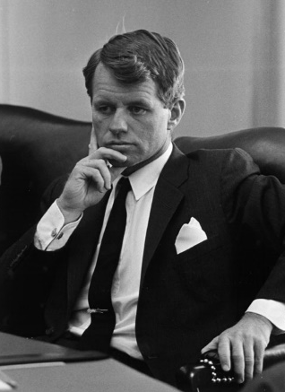
国内生产总值……
“……并没有考虑到我们孩子的健康、他们的教育质量，或者他们做游戏的快乐。它也没有包括我们的诗歌之美和婚姻的稳定，以及我们关于公共问题争论的智慧和我们公务员的廉正。它既没有衡量我们的勇气、我们的智慧，也没有衡量我
们对祖国的热爱。简言之，它衡量一切，但并不包括 使我们的生活有意义的东西；它可以告诉我们关于美 国人的一切，但没有告诉我们为什么我们以做一个美国人而骄傲
参议员罗伯特·肯尼迪，1968
62
Notes:
62
Very scathing words, indeed!

Slide 63
GDP 并没有评价:
环境质量
闲暇时间
非市场性活动，比如家长在家里对他或她孩子的照顾
收入的公平分配
Notes:
63
Much of what Robert Kennedy said about GDP is correct.

Slide 64
为什么我们还要关注GDP?
GDP高的国家能提供更好的学校，更清洁的环境，更好的医疗福利等等
生活质量的许多指标与GDP成正比，比如：
Notes:
64
Then why do we care about GDP?
Because a large GDP does in fact help us to lead a good life. GDP does not measure the health of our children, but nations with larger GDP can afford better health care for their children. GDP does not measure the beauty of our poetry, but nations with larger GDP can afford to teach more of their citizens to read and enjoy poetry. GDP does not take account of our intelligence, integrity, courage, wisdom, or devotion to country, but all of these laudable attributes are easier to foster when people are less concerned about being able to afford the material necessities of life.
In short, GDP does not directly measure those things that make life worthwhile, but it does measure our ability to obtain the inputs into a worthwhile life.

Slide 65
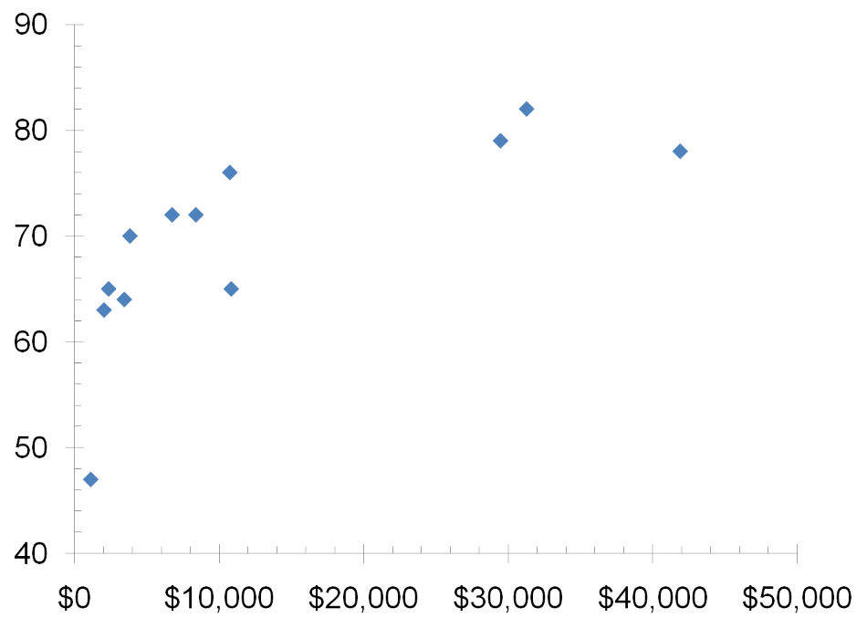
12个国家的GDP和预期寿命
印度尼西亚
日本
中国
美国
墨西哥
德国
巴西
预期寿命 (年)
巴基斯坦
俄罗斯
印度
孟加拉国
尼日利亚
人均真实GDP
65
Notes:
This figure and the two that follow are from the data in Table 3 of the textbook.
Real GDP per capita figures are expressed in U.S. dollars.
Source: Human Development Report 2007/2008, United Nations.

Slide 66
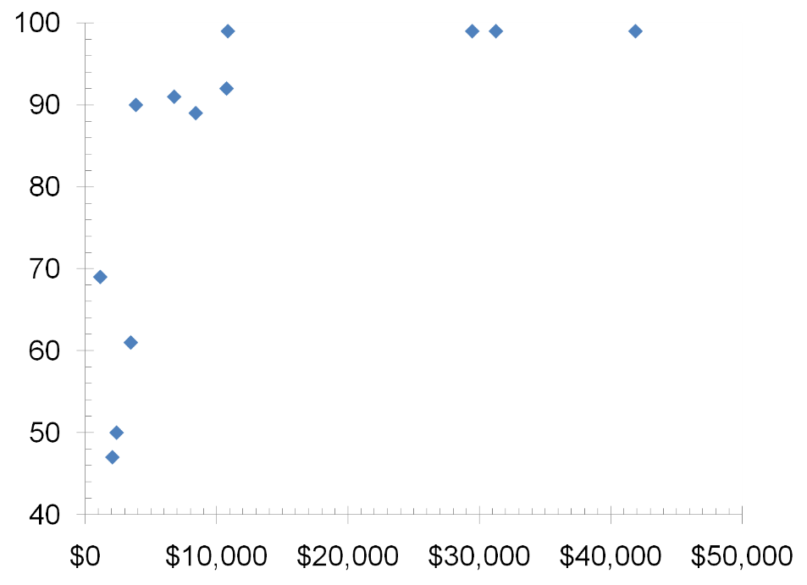
12个国家的GDP与成人识字率
中国
俄罗斯
美国
德国
日本
墨西哥
巴西
印度尼西亚
成人识字率
（占总人口的百分）比)
尼日利亚
印度
巴基斯坦
孟加拉国
人均真实GDP
66
Notes:
Source: Human Development Report 2007/2008, United Nations.

Slide 67
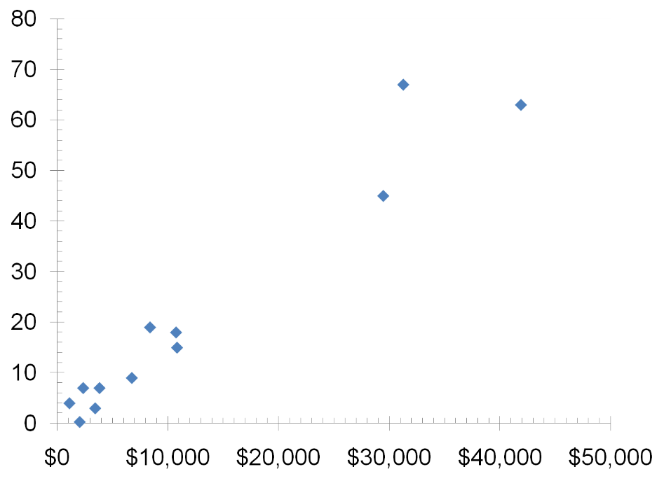
12个国家GDP与网络的使用
日本
美国
网络的使用
( 占总人口的百分比)
德国
巴西
印度尼西亚
墨西哥
巴基斯坦
俄罗斯
中国
尼日利亚
印度
人均真实GDP
孟加拉国
67
Notes:
Source: Human Development Report 2007/2008, United Nations.

Slide 68
本节总结
国内生产总值(GDP) 衡量一国的总收入与支出
GDP的四个支出组成部分包括：消费，投资，政府购买和净出口
名义GDP是用现期价格来衡量，真实GDP是用不变的基年价格来衡量，并经过通货膨胀的校正
GDP虽然不是一个完美的指标，但它仍是衡量一国经济福利的主要指标
68

Slide 69
Thanks!

